Slide 1
Welcome Back!!!
Sujit Molleti

Slide 2
Start recording

Slide 3
Recursion
Week 10

Slide 4
Agenda
Review
Problems
Resources
Questions

Slide 5
Changes
What’s the same
We’ll still be doing problems
We’ll still be meeting at this time
We still have quizzes due in 24 hrs.
What’s different
Quizzes will count for your attendance
Recitations will be recorded
More live coding
Participation

Slide 6
Recursion Checklist
Base case(s) – you can have multiple
The result that can be returned immediately
Recursive Step
DO NOT use recursion inside the main method

Slide 7
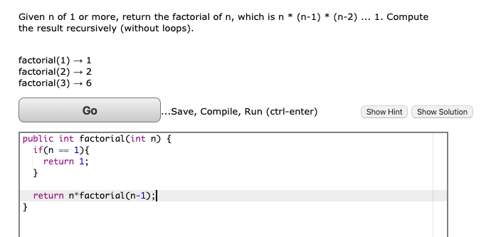
Example
Determine the Base Case(s) and the recursive step

Slide 8
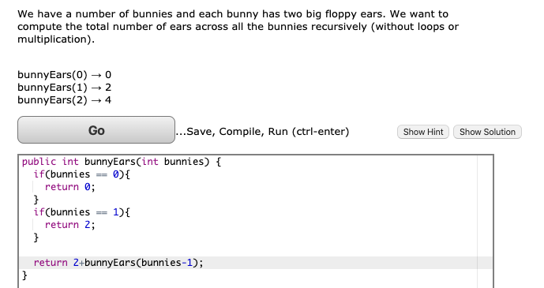
Example
Determine the Base Case(s) and the recursive step

Slide 9
Problems

Slide 10
Quiz Code: XCAK
Section 19

Slide 11
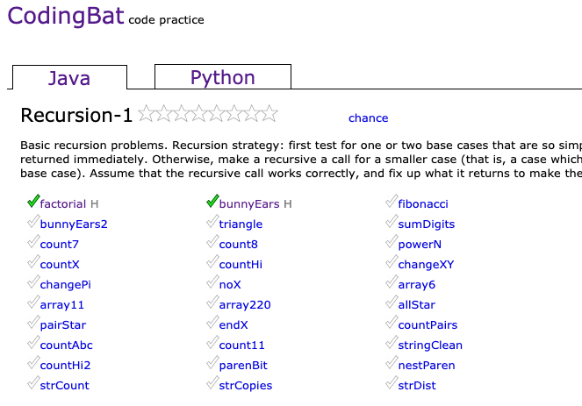
Codingbat.com
Site where you can practice your recursion and other java skills
Optional HW: Finish the first 6

Slide 12
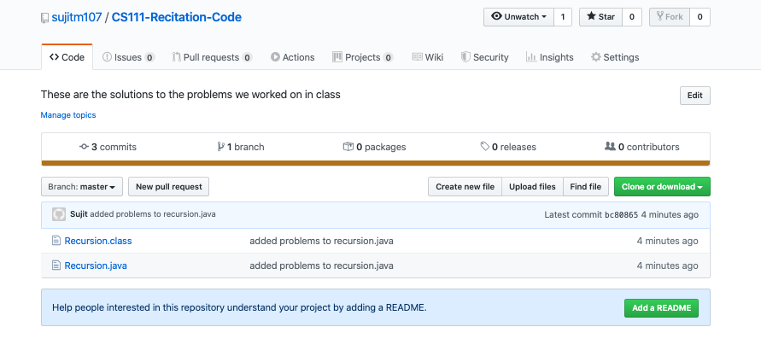
github
I’ll be posting the code that we work on in class here with the problem prompts
https://github.com/sujitm107/CS111-Recitation-Code

